Slide 1

Book-Worm
Web app developed For a book selling company for online customers.

Slide 2
Developers and Work
Moulika Nagulavancha
(700746230)
Admin Dashboard
Manage Books(Add-delete)
Place Order
Payment
Manage Orders
Login/Registration
Kavyasri Avushapuram
(700728990)
User Home(Carousel-Categories)
Books(Filters)
Books details
Similar books
Add to cart
Shopping cart

Slide 3
Project Description
The online bookstore application is a platform that enables users to browse and purchase books. This web-application aims to provide a seamless experience for users who wish to buy books online. It will feature a user-friendly interface and easy navigation.

Slide 4
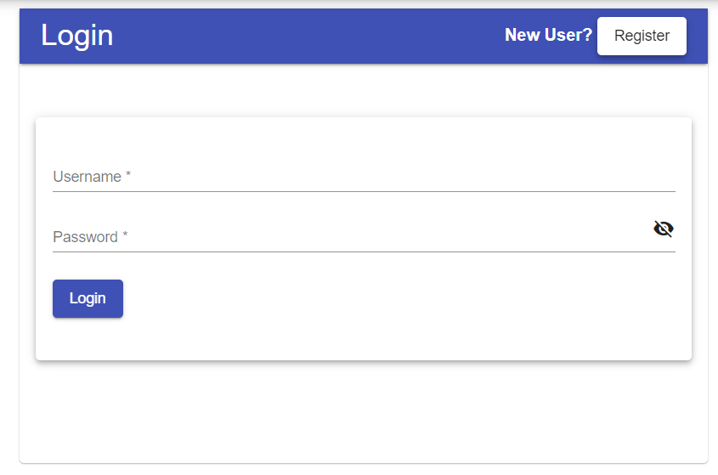
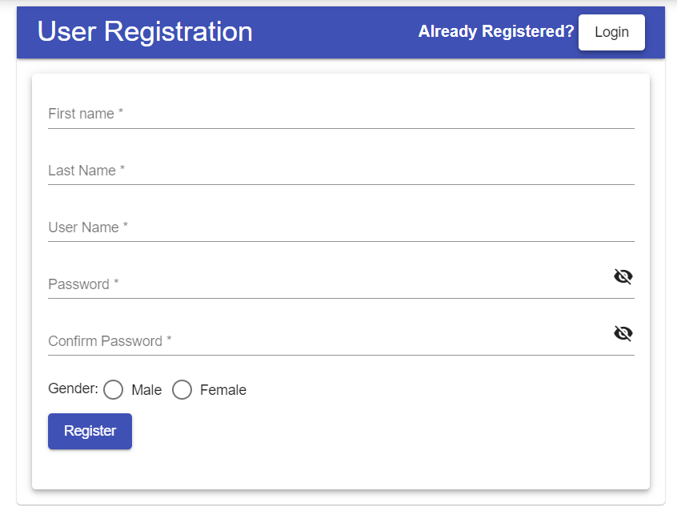
Profile Management
The login page will allow users to log in to the platform as either an admin or a user.
Admins and Users can view books and book details.
Admins will have access to the admin dashboard and can also manage books.
Users will register and then upon login will be able to manage their profile and track their orders.

Slide 5
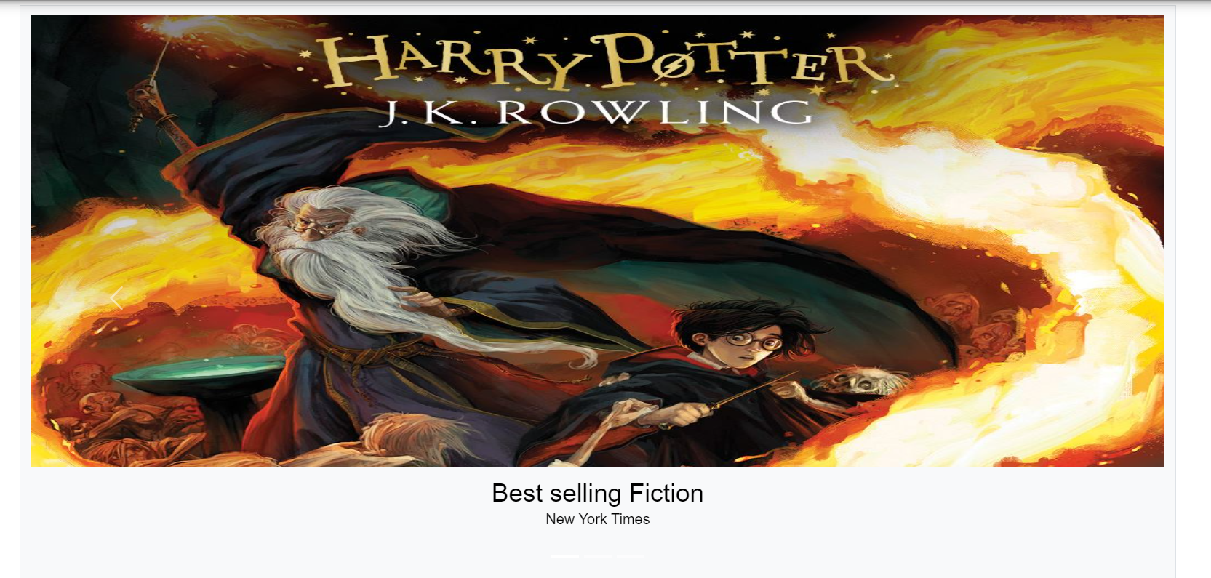
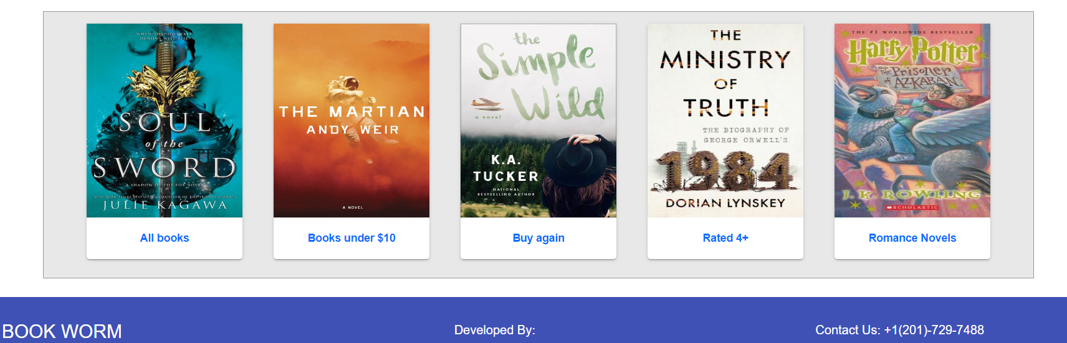
User Homepage
The homepage will feature a carousel, which will display featured books, new releases, and bestsellers.
And there are some recommended categories of books at the bottom.
The search feature will allow users to browse/search for books using keywords, book title.
User profile is visible on the top right of every page when logged in.

Slide 6
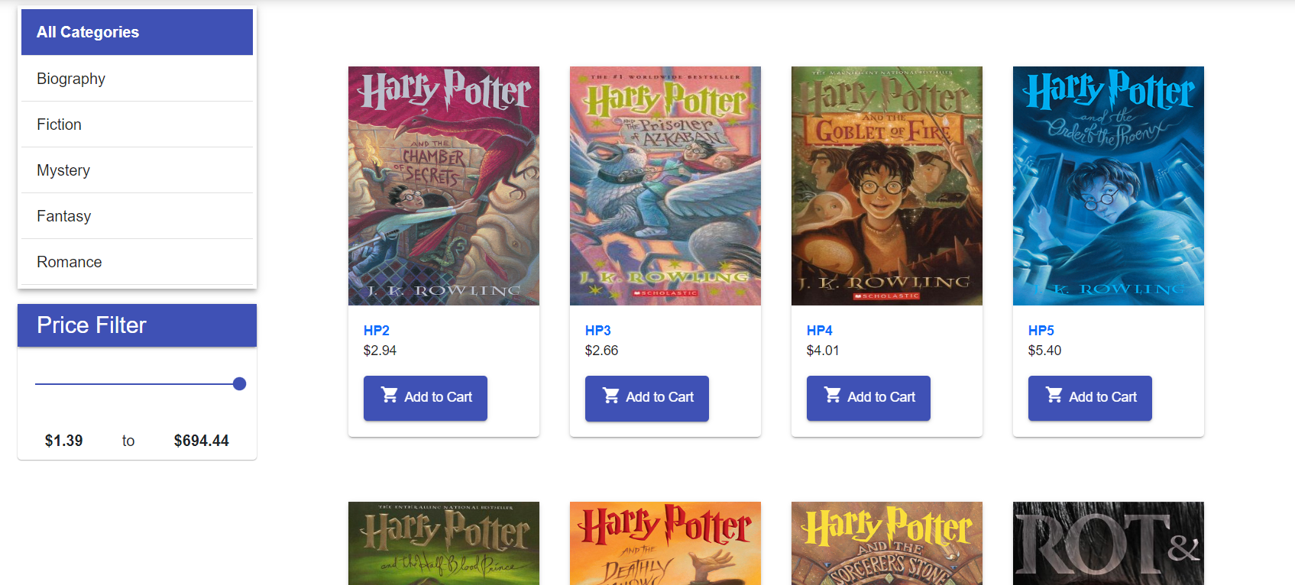
Book Browsing and Filtering
The book catalog will display all the books available on the platform, with book title, book price and quick link to add to the cart.
We can also filter the books by price range or category.

Slide 7
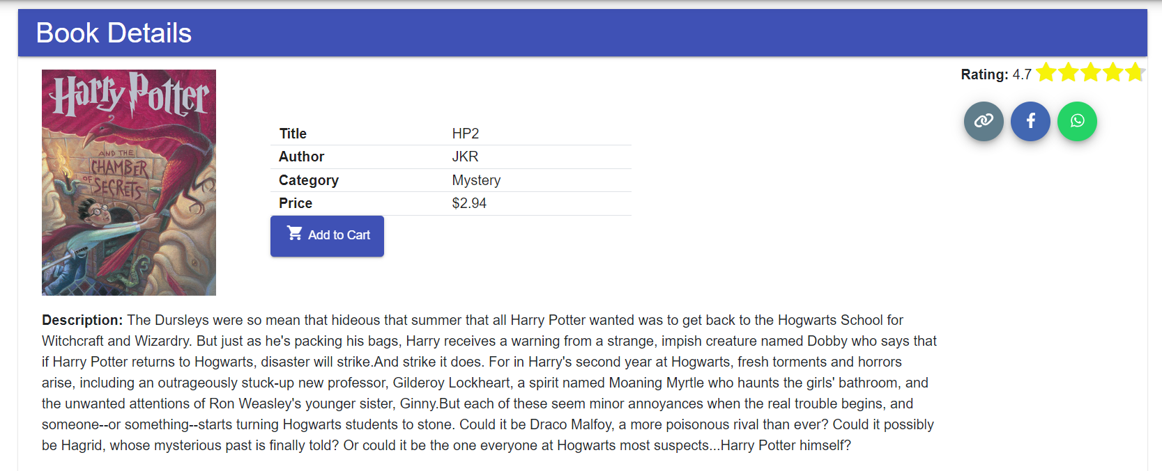
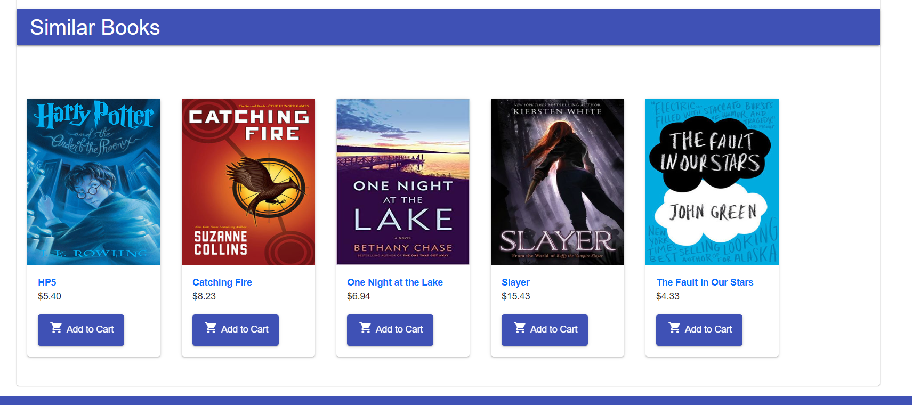
Book Details and Sharing
When a user/admin clicks on a book, they will be taken to the book details page. Display book title, book cover (which can be enlarged when hovered), author, book description, category, book rating.
User can add this book to cart for buying or share this book to someone by using the link or through platforms like Facebook and WhatsApp.
Additionally, User can also view similar books at the bottom.

Slide 8
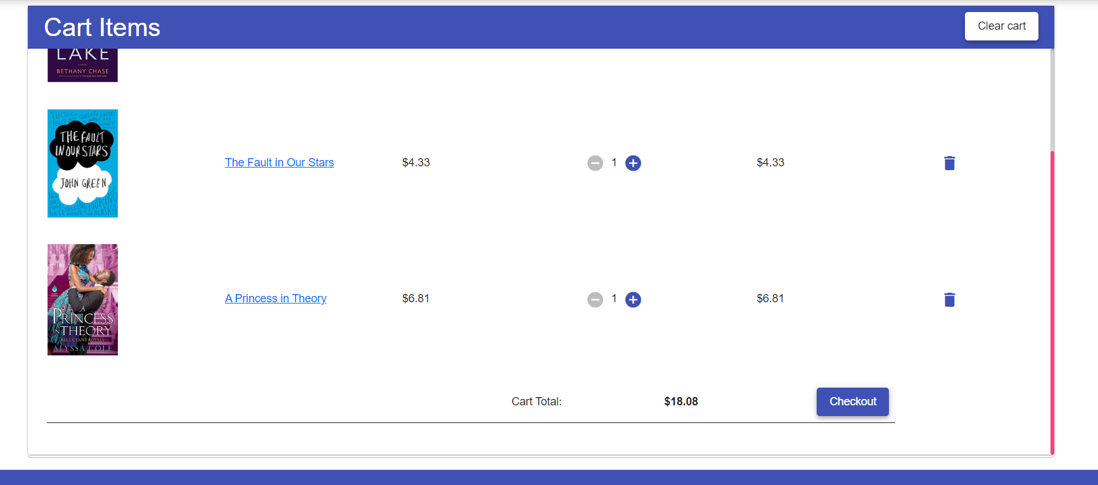
Shopping Cart
The 'add to cart' feature will allow users to add books to their shopping cart.
Users will be able to view the contents of their shopping cart, update the quantity of books, and remove books from their shopping cart.
When a user is ready to check out, they will be taken to the checkout page

Slide 9
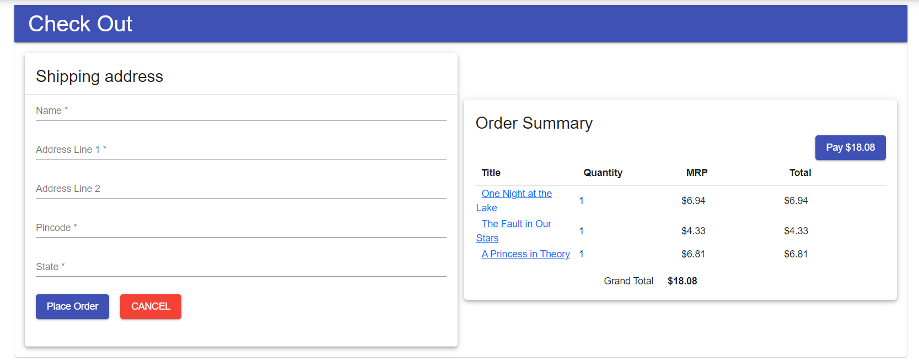
Place Order
This page will allow user to place an order.
First a user must enter his/her shipping address.
Then they need to make a payment and place order.

Slide 10
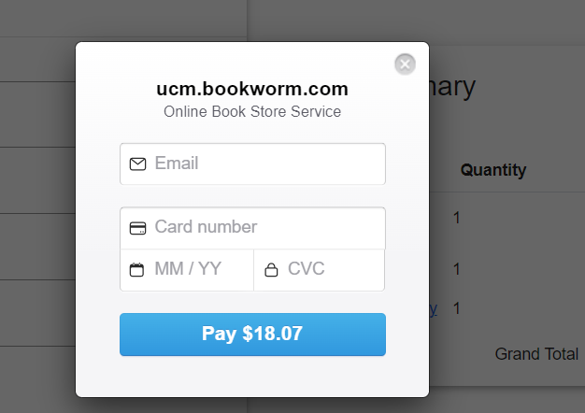
Payment
User need to enter their card details to make a payment.

Slide 11
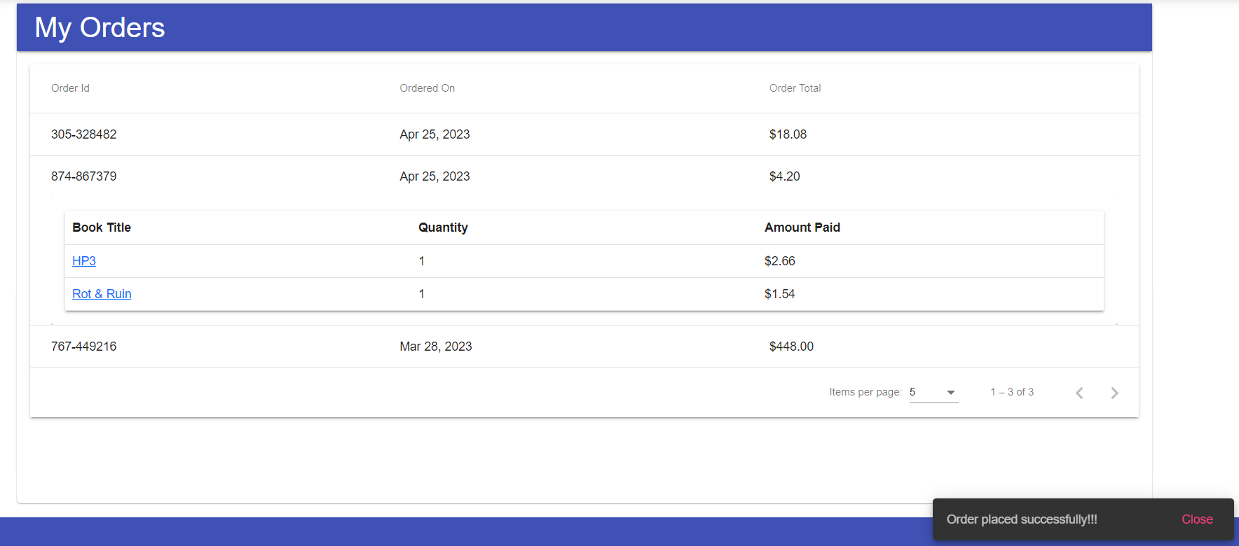
Manage Orders
After an order is placed, we can view it under My Orders.
As a part of profile management , a user can view and manage his orders from the past aswell.

Slide 12
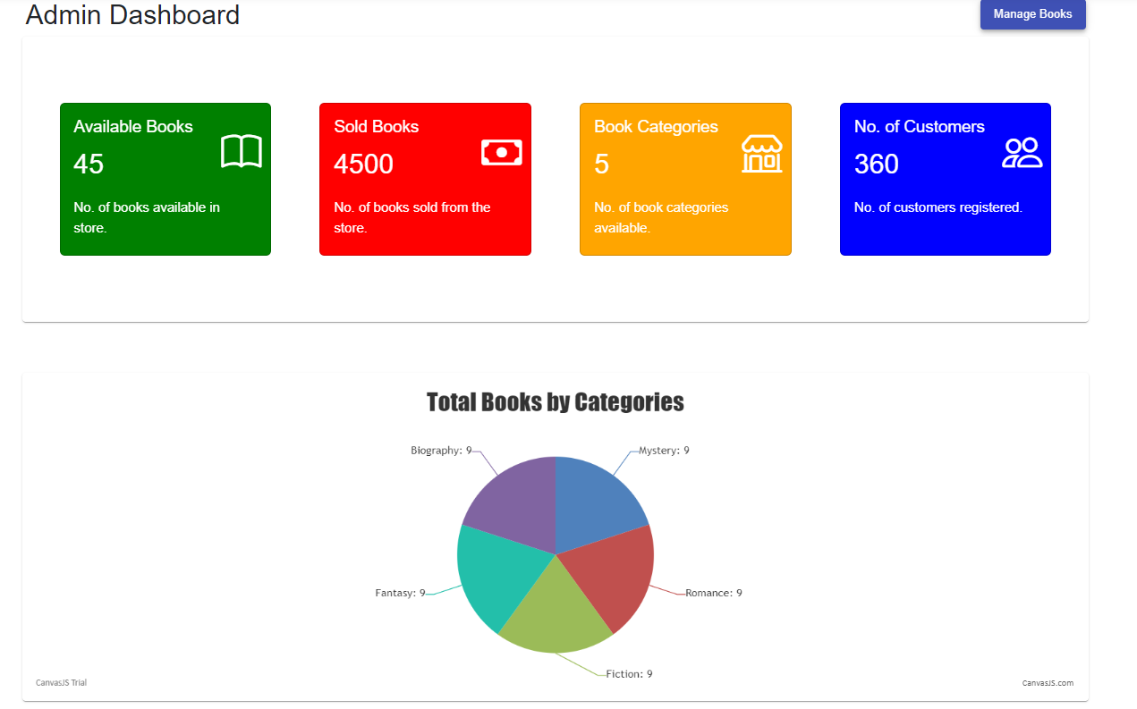
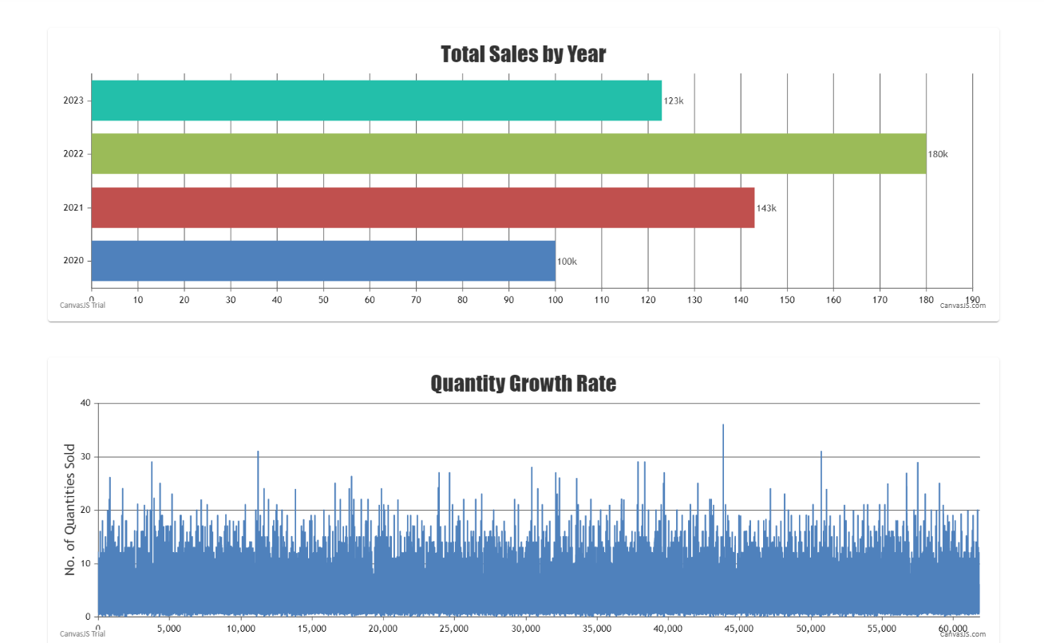
Admin Dashboard
This page is visible when logged in as admin.
Admins can view statistics of available books, books sold, categories etc.,
They can also visualize yearly sales, category division, quantity growth etc.,

Slide 13
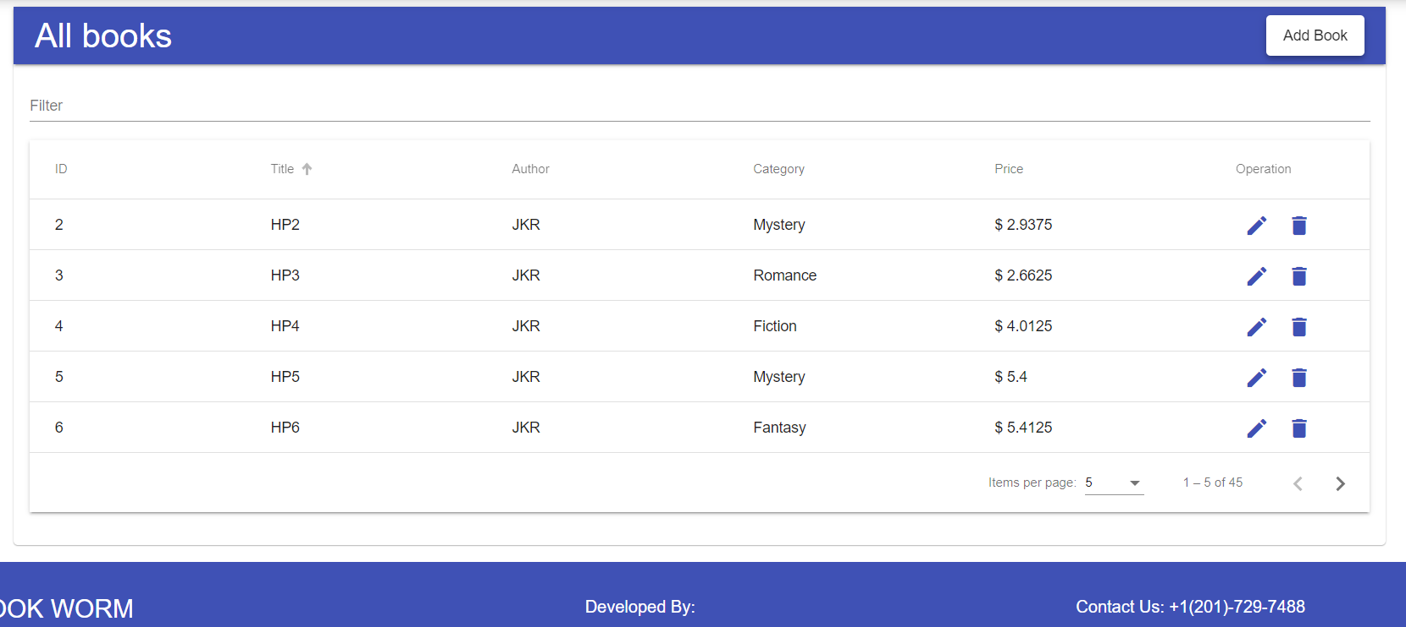
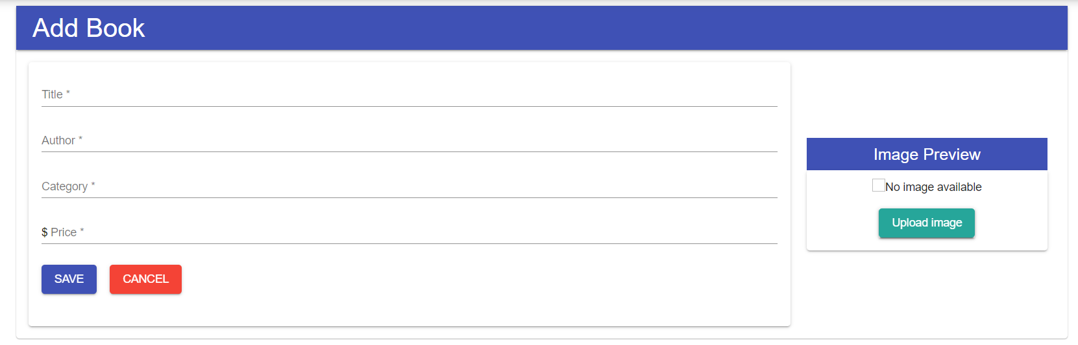
Admin Manage Books
Admin can add new books to existing catalog.
They can also edit the information on a book.
Finally, they can delete a book from catalog when they are out of stock or not selling anymore.

Slide 14
Tech Stack
Front End
Angular 14.x, Angular Material
Typescript
Bootstrap 3.x
CSS 3
HTML 5
Canvas JS
STRIPE
Back End
Open RestAPI for book data.
JSON for charts data and books additional info.
Local storage.

Slide 15
Demo

Slide 16
Summary
This project aims to create an online book-store platform that will provide users with a convenient and user-friendly platform to browse and purchase books.
The web application will have a login page, two types of users (admin and user), a homepage with a carousel, search feature and filters, book catalog, book details, add to cart feature, checkout and purchase feature and admin dashboard feature.
The platform will be designed to be scalable and modular, making it easy to add new features and functionalities in the future.

Slide 17


THANK YOU

